Slide 1
Filling Out a Job Application Correctly
by doug Crawford, sphr, SHRM-SCP Job-Applications.com

Slide 3
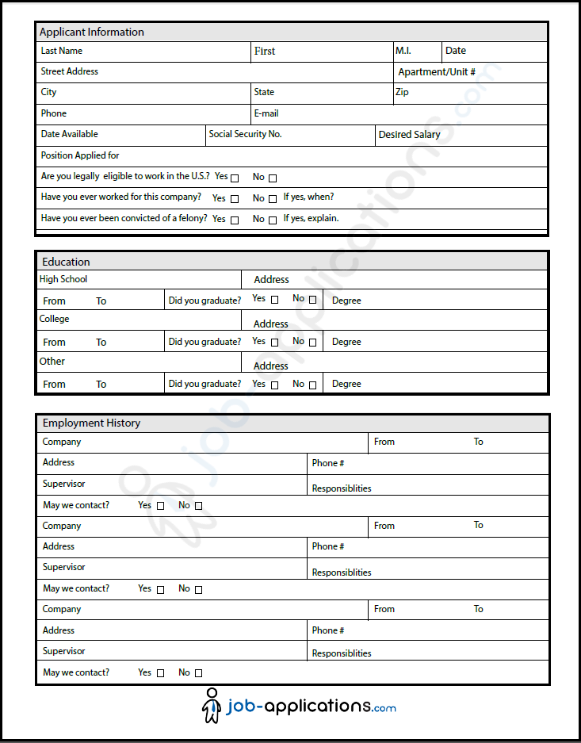
Paper Applications

Slide 4
Standard Tips and Practices
When filling out paper applications, use blue or black ink.
Print legibly.
If you don’t understand a section or a question, do not be afraid to ask for assistance.
Answer all questions relating to legalities with honesty.
Read all agreements, disclosures, and disclaimers carefully before signing.

Slide 5
Applicant Information

Slide 6
Employment History

Slide 7
Education

Slide 8
References

Slide 9
Disclaimers

Slide 10
Online Applications

Slide 11
Filling Out An Online Application
Most online application forms follow the same format of paper applications.
Carefully fill out each section, checking for possible typos, spelling errors, and ensuring all information is up-to-date before submission.
Certain job sites allow for applicants to create a profile.
Profiles tend to use standard applications to be saved and used repeatedly for other jobs available from the employer.
Profile information may be saved for varying lengths of time before needing resubmitted.
Most online applications are paired with pre-employment assessments.

Slide 12
Pre-Employment Screenings
Before you’re able to submit your completed application, some online job portals prompt users to take pre-employment screenings.
While each screening may test different aptitudes, the majority become familiar and may even feel repetitious over time.
Preparing for such screenings usually means answering honestly and providing the answer you believe a potential employer would like to hear.

Slide 13
Pre-Employment Screenings
Skills Tests
Behavioral Tests
Cognitive Tests
Skills tests generally assess a potential employee’s abilities when it comes to on-the-job aptitude, as well as a working knowledge of programs directly related to day-to-day activities.
Such tests may also examine previous relatable skillsets and how well the employee retains knowledge applicable to the job at hand.
A behavioral test evaluates how well a new employee will react to situational and hypothetical moments on the job.
Additionally, these assessments tend to examine socializing, teamwork, customer service (where appropriate), timeliness, and effort on the job.
Sometimes a combination of the two, cognitive testing literally tests a person’s capabilities as well as direct capacities for workable knowledge.
Cognitive testing may also judge practical skills, such as reading comprehension and basic math understanding.

Slide 14
Application Sections With Multiple Answers
Typical Question
Best Answer
Salary Expectations?
Potential Start Dates?
Research similar positions and base what you ask for on personal need, relatable experience, and industry standards.
When currently employed, use a start date at least two weeks out from the current date.

Slide 15
Application Sections With Multiple Answers
Typical Question
Best Answer
Contact Current Employer?
References?
Availability?
It’s okay to check “No.”
Always use professional references unless otherwise noted.
Mark “open availability” when applicable. You can always discuss when you can’t work during interviews.

Slide 16
So What Have We Learned?
Paper Applications vs Online Applications
What are some of the major differences?
Similarities?
Pre-Employment Screenings
What are they?
How should you prepare?
Questions With Multiple Answers
How best do we answer the following:
May we contact your current employer?
What are your salary expectations?
What is your availability?
When can you start?

Slide 17
Additional Resources
For more information about creating a resume, check out the following resources from Job-Applications.com:
http://www.job-applications.com/
http://www.job-applications.com/blog/
https://www.youtube.com/user/MrJobApplications
http://www.job-applications.com/video-library/
https://www.facebook.com/JobApplications

